Slide 1

CURRENCY EXCHANGE RATE FORECASTING
Name:Mohankumar(9922146010) Project Guide: Dr. M. Ilayaraja
M.Sc Data Science,2nd Year Assistant Professor,CS&IT.
Domain: Data science

Slide 2
ABSTRACT
The impact of fluctuations in currency exchange rates on a nation's economy underscores the critical need for precise forecasting within the realm of the money market.
This research delves into the efficacy of various hybrid models, namely LSTM-ARIMA, LSTM-SVR, LSTM-RF, and SVR-RF, in their capacity to predict FOREX fluctuations.
Leveraging datasets containing information on EUR/INR, NZD/USD, and USD/INR, this study meticulously evaluates the performance of each model. The findings consistently demonstrate that the LSTM-SVR hybrid model exhibits superior predictive capabilities compared to its counterparts.
By employing the adaptive learning rate method (ADAM) optimization approach, this research endeavors to ascertain the optimal weights for the suggested model.
This innovative methodology not only enhances precision but also provides a more nuanced understanding of foreign exchange rate estimation. The commendable performance of the LSTM-SVR hybrid model underscores its potential as a robust forecasting tool for discerning currency exchange rate movements.
These insights carry significant implications for policymakers, financial institutions, and investors alike, as they navigate the intricacies of the global currency market with heightened accuracy and confidence.

Slide 3
INTRODUCTION
A currency exchange rate is the value of one currency compared to another. It represents how much one currency can be exchanged for another. Exchange rates fluctuate based on various factors such as supply and demand, economic stability, geopolitical events, and government policies.
Currency exchange rates serve several purposes:
International trade: Exchange rates directly impact the competitiveness of a country's exports and imports. A favorable exchange rate can make exports cheaper and imports more expensive, boosting a country's trade balance. Forecasting exchange rates helps businesses anticipate potential fluctuations and plan their international transactions accordingly.
Economic Stability: Fluctuations in exchange rates can have a profound impact on a nation's economy. Sudden and significant changes in exchange rates can disrupt trade flows, affect balance of payments, and influence inflation rates. By forecasting exchange rates, policymakers can implement appropriate monetary and fiscal policies to promote economic stability and growth.
Investment Decisions: Investors often make decisions based on expected changes in exchange rates. A strong currency can attract foreign investment, while a weak currency can make domestic assets more attractive to foreign investors. Accurate exchange rate forecasts help investors manage their currency exposure and make informed investment decisions..
Monetary Policy: Central banks use exchange rate forecasts to formulate monetary policies aimed at achieving specific economic objectives, such as price stability, full employment, and economic growth. Understanding future exchange rate movements helps central banks adjust interest rates and intervene in currency markets effectively.

Slide 4
PROBLEM STATEMENT
Complexity of Exchange Rate Dynamics: Exchange rates are influenced by a myriad of factors, including macroeconomic indicators, geopolitical events, monetary policies, and market sentiment. The intricate interplay between these factors creates a highly complex and dynamic environment, making exchange rate forecasting inherently challenging.
Volatility and Uncertainty: Exchange rates are inherently volatile and subject to sudden fluctuations due to unexpected events and market reactions. The presence of uncertainty further complicates forecasting efforts, as future exchange rate movements may be influenced by unforeseen developments and external shocks.
Data Limitations and Noise: Currency exchange rate data often contain noise, irregularities, and missing values, posing challenges for model development and evaluation. Moreover, the availability and quality of data vary across currency pairs and time periods, requiring careful selection and preprocessing of datasets.
Model Selection and Performance Evaluation: Choosing the most appropriate forecasting model and evaluation metrics is a critical decision in currency exchange rate forecasting. Various methodologies, including time series analysis, econometric models, machine learning algorithms, and hybrid approaches, offer different strengths and limitations, requiring careful consideration of their applicability and performance in different market conditions.

Slide 5
EXISTING SYSTEM
Existing System | Its Weaknesses
Time Series Analysis: This involves analyzing historical exchange rate data to identify patterns and trends, often using techniques such as ARIMA, SARIMA,VAR or exponential smoothing. | struggle with capturing sudden changes or anomalies in the data and may not incorporate external factors influencing exchange rates.
Technical Analysis: This method analyzes historical price charts and patterns to predict future movements. | Susceptible to false signals and market noise. It often disregards fundamental factors driving exchange rate movements, which can limit its effectiveness in longer-term forecasting.
Econometric Models: These models attempt to quantify the relationships between exchange rates and various economic indicators like interest rates, inflation, and GDP. | Requires complex data analysis and may struggle with short-term forecasting due to the lagged nature of economic indicators.
Machine Learning: Algorithms learn from vast datasets to identify patterns and predict future rates. Popular algorithms include Neural Networks and Support Vector Machines, but they require data preparation and interpretation expertise. | Requires extensive data preparation and feature engineering. Interpretability of results may be challenging, and overfitting can be a concern without proper regularization techniques.

Slide 6
PROPOSED SYSTEM
The Proposed System for currency exchange rate forecasting will use a Hybrid Approaches to predict future exchange rates. The proposed hybrid method combines traditional time series models with machine learning algorithms to forecast currency exchange rates. By blending these methodologies, the approach aims to overcome the limitations of each method individually, providing improved accuracy, robustness, and adaptability in forecasting exchange rates over various time horizons.
Among these algorithms, LSTM, SVR, ARIMA, and RF are prominent choices due to their effectiveness in handling different types of data and capturing complex patterns. Below is an overview of these algorithm combinations:
LSTM-ARIMA
LSTM-SVR
LSTM-RF
SVR-RF

Slide 7
STRENGTHS OF PROPOSED SYSTEMS
Improved Accuracy: By combining LSTM models with machine learning algorithms, the hybrid approach leverages the strengths of both methodologies, resulting in more accurate exchange rate forecasts compared to using either method alone.
Robustness: The hybrid models are designed to be robust against fluctuations and noise in currency exchange rate data. The integration of multiple techniques enhances the model's ability to handle different types of data patterns and market conditions.
Adaptability: The hybrid approach allows for flexibility in adapting to changing market dynamics and varying time horizons. It can adjust its forecasting strategies based on evolving trends and shifts in the economic landscape.
Complementary Strengths: LSTM models excel in capturing long-term dependencies and patterns in time series data, while machine learning algorithms offer versatility and can capture complex relationships within the data. By combining these strengths, the hybrid models provide a comprehensive and nuanced analysis of exchange rate movements.
Reduced Overfitting: Integrating multiple models can help mitigate the risk of overfitting, where a model learns to memorize the training data rather than generalize to unseen data. The hybrid approach promotes a more balanced model that generalizes well to new exchange rate data.
Enhanced Performance Across Time Horizons: The hybrid models are capable of forecasting exchange rates across various time horizons, from short-term fluctuations to long-term trends. This versatility enables stakeholders to make informed decisions based on forecasts tailored to their specific investment or trading strategies.

Slide 8
HARDWARE AND SOFTWARE REQUIREMENTS
Hardware Requirements:
Windows 10
8GB Ram
256 internal memory
intel processor
Software Requirements:
Anaconda navigator(Anaconda jupyter)
VS code
Django

Slide 9
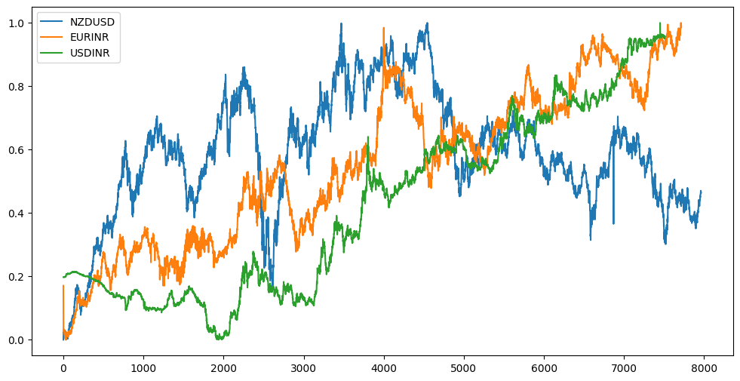
DATASET DESCRIPTION
Three datasets downloaded from Google Finance database. These three datasets have the following attributes which are used for the forecasting task.
• Date
• Close
The last attribute which is close is used for output and forecasting each day close price.
 | NZD/USD | EUR/INR | USD/INR
Data range | 2002-2023 | 2002-2023 | 2002-2023
No. of observations | 7964 | 7512 | 7716

Slide 10
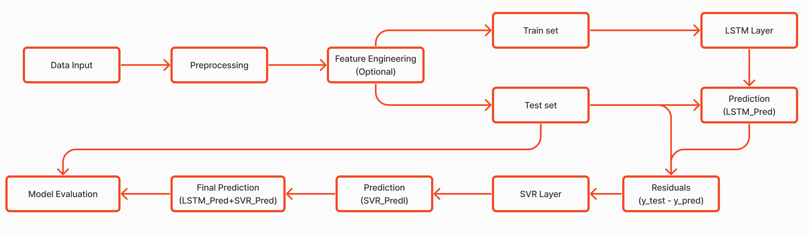
WORK FLOW DIAGRAM FOR PROPOSED MODEL
This approach can be building other hybrid models

Slide 11
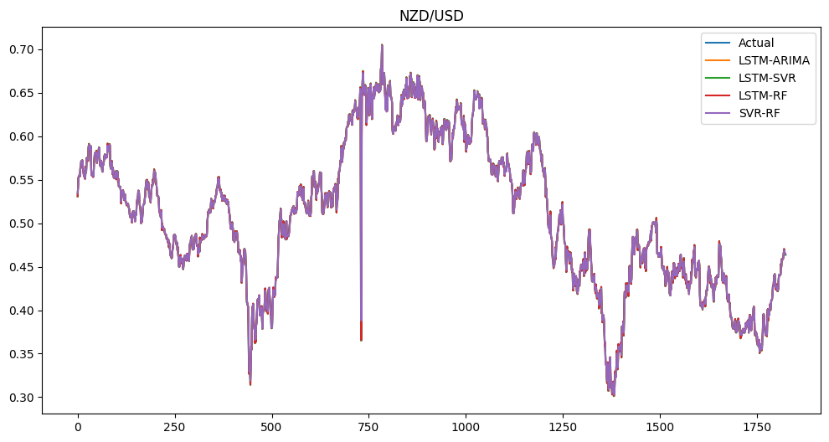
RESULTS AND DISCUSSION
NZD/USD Currency Pair :To make it visualize model evaluation and more understandable that how much the models is able to forecast these, better is visualized to show how close or far the prediction and the real values are
NZD/USD | MAE | MSE | RMSE
LSTM-ARIMA | 0.0042453 | 0.00006747 | 0.008214
LSTM-SVR | 0.00005968 | 4.86E-09 | 6.97594E-05
LSTM-RF | 0.005924 | 0.000155 | 0.01248
SVR-RF | 0.0062535 | 0.00015 | 0.012436

Slide 12
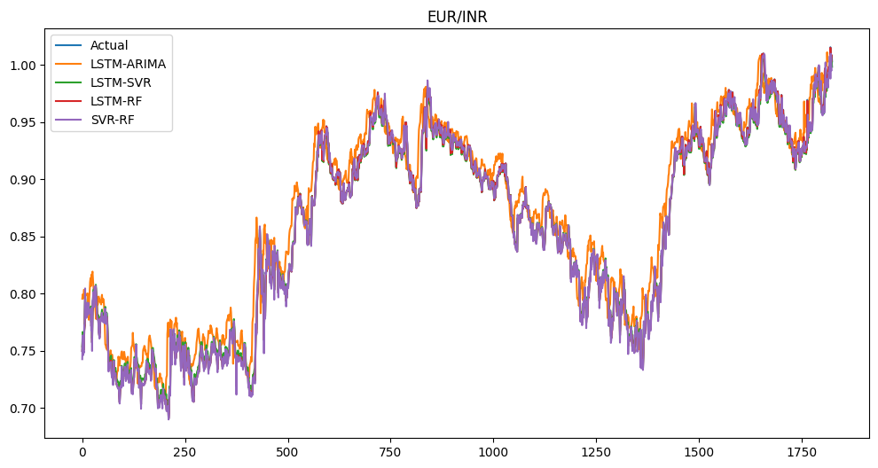
RESULTS AND DISCUSSION
EUR/INR Currency Pair :To make it visualize model evaluation and more understandable that how much the models is able to forecast these, better is visualized to show how close or far the prediction and the real values are
EUR/INR | MAE | MSE | RMSE
LSTM-ARIMA | 0.011947 | 0.000208 | 0.014432
LSTM-SVR | 0.001744 | 0.00000417 | 0.002044
LSTM-RF | 0.00438 | 0.0000516 | 0.00719
SVR-RF | 0.00555 | 6.56E-05 | 0.0081

Slide 13
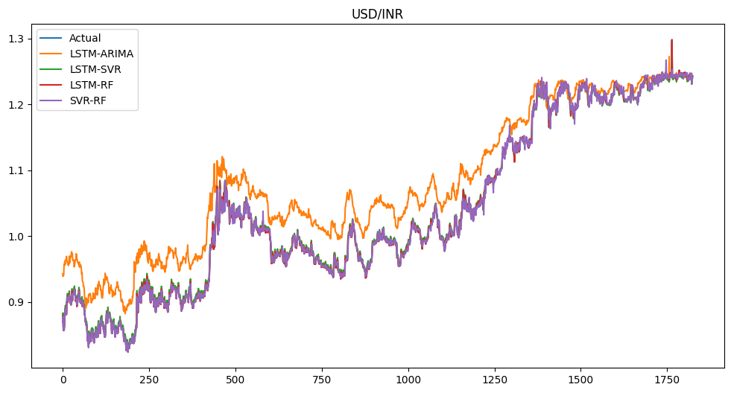
RESULTS AND DISCUSSION
USD/INR Currency Pair :To make it visualize model evaluation and more understandable that how much the models is able to forecast these, better is visualized to show how close or far the prediction and the real values are
USD/INR | MAE | MSE | RMSE
LSTM-ARIMA | 0.0260441 | 0.0008961 | 0.0299359
LSTM-SVR | 0.006235 | 0.00004498 | 0.0066707
LSTM-RF | 0.004382 | 0.000051438 | 0.0071859
SVR-RF | 0.0058193 | 0.000075933 | 0.008714

Slide 14
CONCLUSION AND FUTURE WORK
This study developed four models to forecast three pair currency prices in Forex market comparatively. The models are worked well.
LSTM-SVR outperformed other three models and LSTM-ARIMA performed least than others. The procedure is described in details, from head to tail.
The model’s performance was great due to rich data on the training phase. But the fact that different factors still remain which the currency rate has many aspects thus forecasting only time series and historical data is good but not enough.
the first future work can be a combination of historical data with daily financial and political news analysis with Natural Language Processing (NLP) models.

Slide 15

REFERENCES
http://docs.neu.edu.tr/library/6721800683.pdf
https://www.imperial.ac.uk/media/imperial-college/faculty-of-natural-sciences/department-of-mathematics/math-finance/Nielsen_Laurids-Gert_01424460.pdf
https://www.mdpi.com/1911-8074/15/1/2
Exchange Rate Forecasting via a Machine Learning Approach (scirp.org)
https://cs229.stanford.edu/proj2018/report/76.pdf

Slide 16
THANK YOU
If any queries, contact mohankumar.ramadas@gmail.com

